Slide 1
Chemistry – Jan 8, 2020
P3 Challenge-
Consider a Calcium atom with 22 neutrons. Determine…
A) Draw the symbol complete with atomic number, mass number, and charge (if there is one.)
B) Draw a Bohr model for the atom
C) State the highest energy level and the number of valence elcetrons.
Objective –
Atomic Structure/Quantum Mechanics
Get out Bohr Model WS for HMK Check

Slide 2
Chemistry – Jan 8, 2020
Objective –
Atomic Structure / Quantum Mechanics
Agenda
HMK review
QM overview and video
Organization of orbitals via Activity
Assignment: Atomic Structure Exploration Activity

Slide 3
Quantum Mechanics
Same as Bohr model except for how the energy levels are described.
Electrons located in orbitals.
Mathematical description is a “wave function” – Schrödinger
Explains the wave property of matter.
Strategy to understand QM:
Learn what the orbitals look like and how they’re organized on H atom with activity (today)
Populate the orbitals with electrons to describe other atoms using the periodic table (next time)

Slide 4
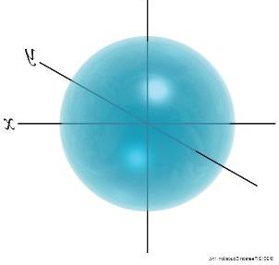
Shapes of Orbitals
Using different shapes is one way QM creates its quantized energy levels.
The more complicated the shape, the higher the energy level.
Four different basic orbital shapes: s p d f
Basic shapes double the number of lobes for each level:
s, sphere p, dumbbell d, puffy 4 leaf clover f, complex

Slide 5
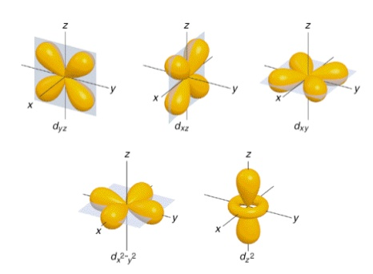
S, P, D, and F Orbitals

Slide 6
Overview Video
Orbitals, the Basics: Atomic Orbital Tutorial — probability, shapes, energy; Crash Chemistry Academy
https://www.youtube.com/watch?v=Ewf7RlVNBSA

Slide 7
Atomic Structure Exploration Activity
Obtain a copy of the subshell sheets and an envelope, one set per lab table, a box of colored pencils and a pair of scissors.
Complete an activity sheet for each team member.
Due by end of period
Submit an envelop of your atomic structure pieces labeled with all team member names
Work in groups of 3-4 on the Atomic Structure Exploration Activity.

Slide 9
Exit Slip - Homework
Exit Slip:
What’s Due? (Pending assignments to complete.)
Atomic Structure Exploration Activity
What’s Next? (How to prepare for the next day)
Read Holt p84 - 88

